Slide 1
Welcome To Our Presentation

Slide 2
A. F. M. Rafiul Hassan
ID- 22-47048-1
Md. Sanim
ID-21-44606-1
Md. Arafat Alam Leon
ID-22-47118-1
Group Member
Md. Tanziul Haque
ID-22-46435-1
Tasurron Nazerin Nafisa
ID-22-47386-2

Slide 3
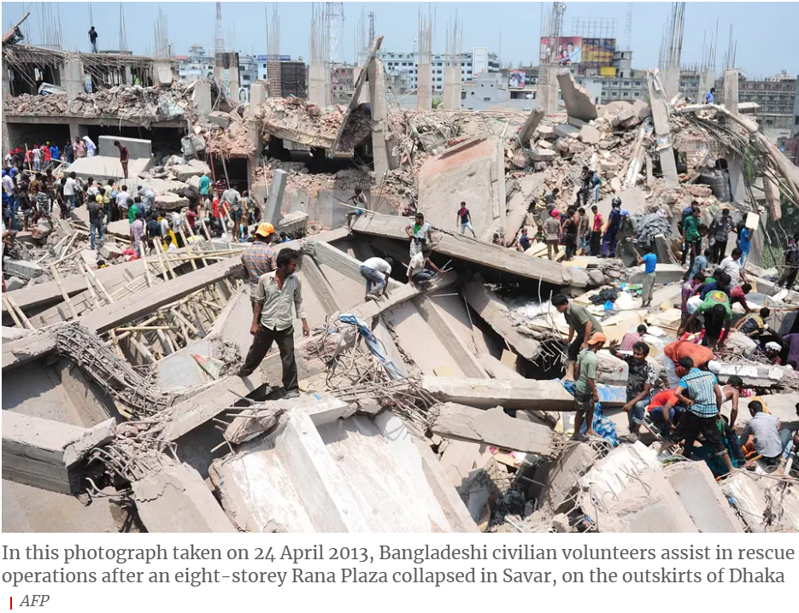
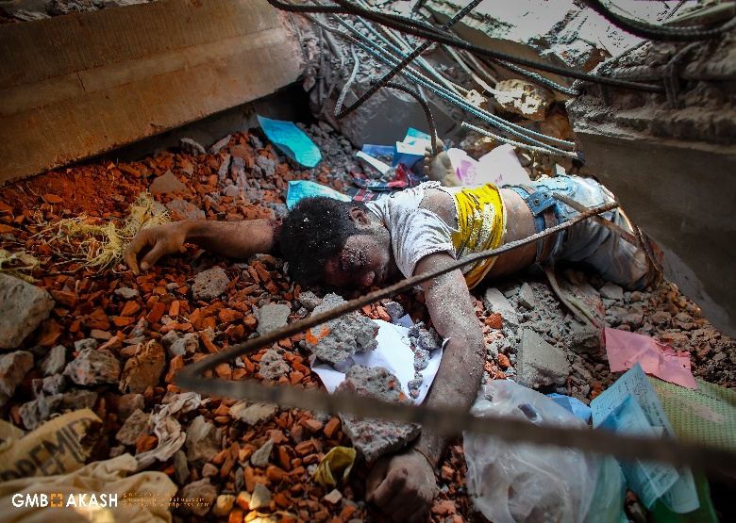
INTRODUCTION
Rana Plaza
Collapsed
April 24, 2013

Slide 4
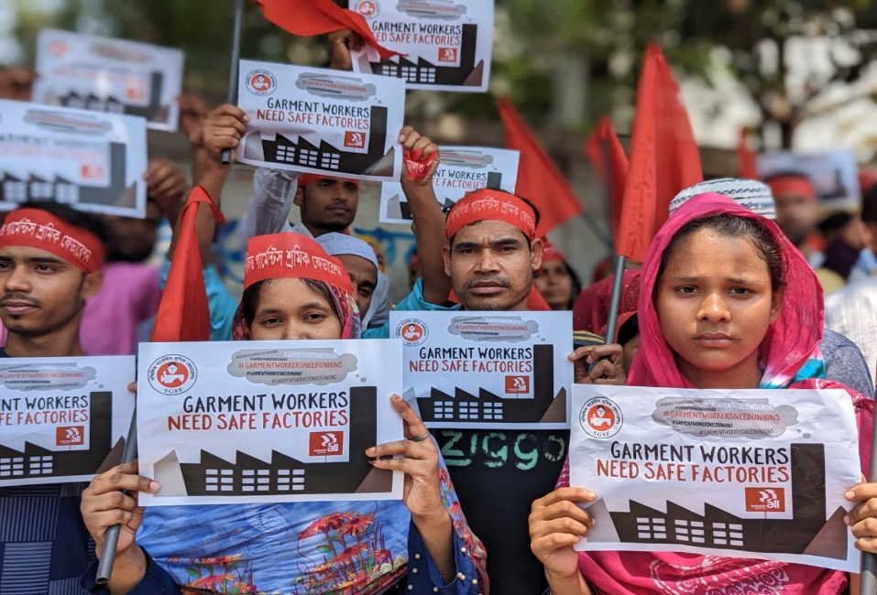
Key Aspects of the Rana Plaza Tragedy
Unsafe Building Conditions
1
Ignored
Warnings
2
Global
Response
3
Demanded
for
Justice
4

Slide 5
Code of Ethics
IEEE CODE OF ETHICS 1
Rule-01: To hold paramount, the safety, health, and welfare
of the public, to strive to comply with ethical design and
sustainable development practices, to protect the privacy of others, and to disclose promptly factors that might endanger the public or the environment.
Rule-02: To avoid real or perceived conflicts of interest
whenever possible, and to disclose them to affected parties when they do exist.
IEEE CODE OF ETHICS 2
Rule-07: To treat all persons fairly and with respect, and to
not engage in discrimination based on characteristics such
as race, religion, gender, disability, age, national origin,
sexual orientation, gender identity, or gender expression.

Slide 6
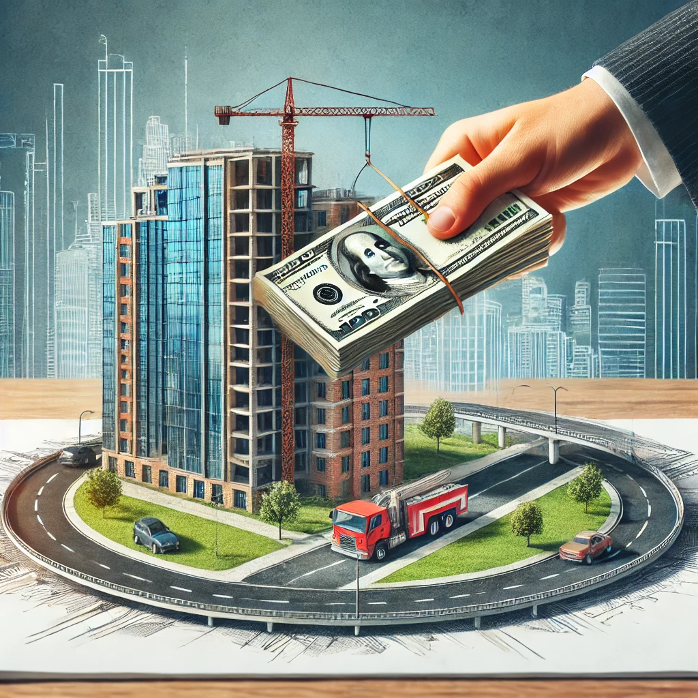
Ethical Code Violation
Rule-1- Neglect of Worker Safety
Ethical failures in prioritizing health and safety in
construction and operations.
Impact of ignoring warnings and endangering
public welfare.
Rule-3-Corruption and Conflict of Interest
Analysis of unethical approvals and them
consequences.
Role of governance failures in facilitating
unsafe conditions.

Slide 7
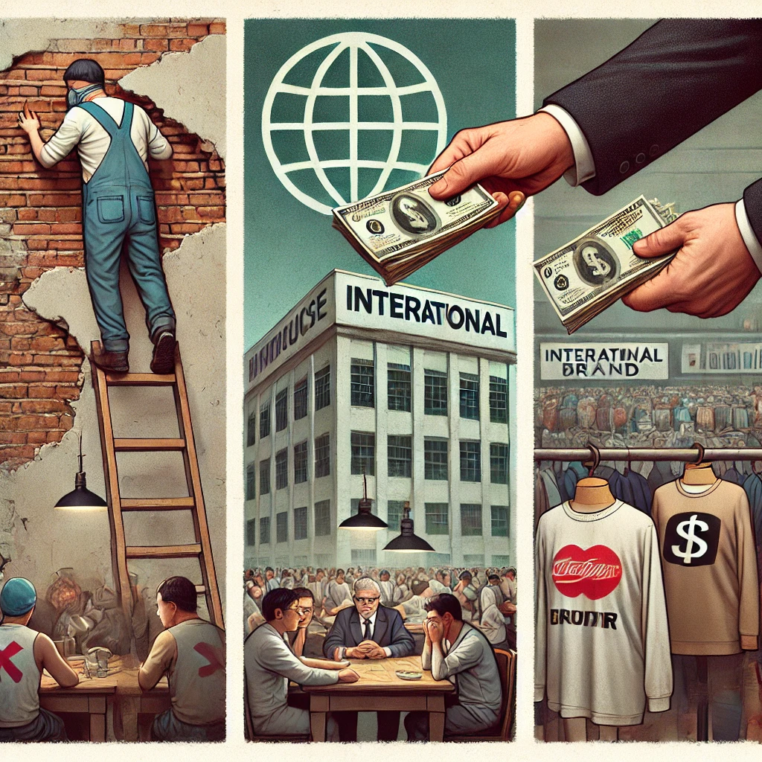
Ethical Code Violation
Rule-7- Fair Treatment and Exploitation of Workers
Exploitation of low-wage workers in global supply
chains.
Ethical responsibilities of international brands
toward fair labor practices.

Slide 8

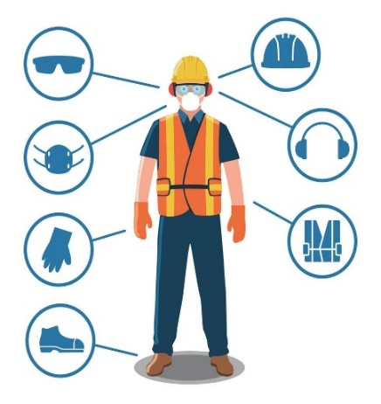
Ethical Dilemma
profit motives
Worker safety.

Slide 9
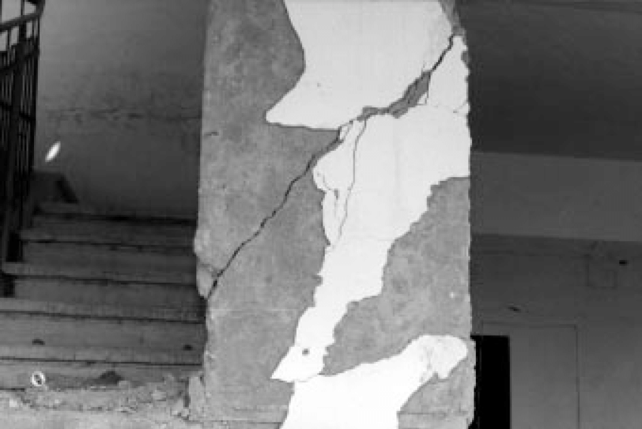
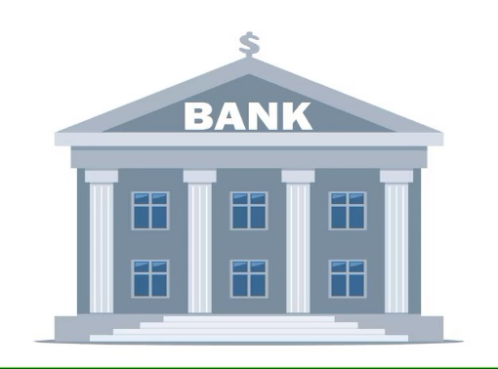


Key Dilemma
Close
Pressure
production
Crack

Slide 10
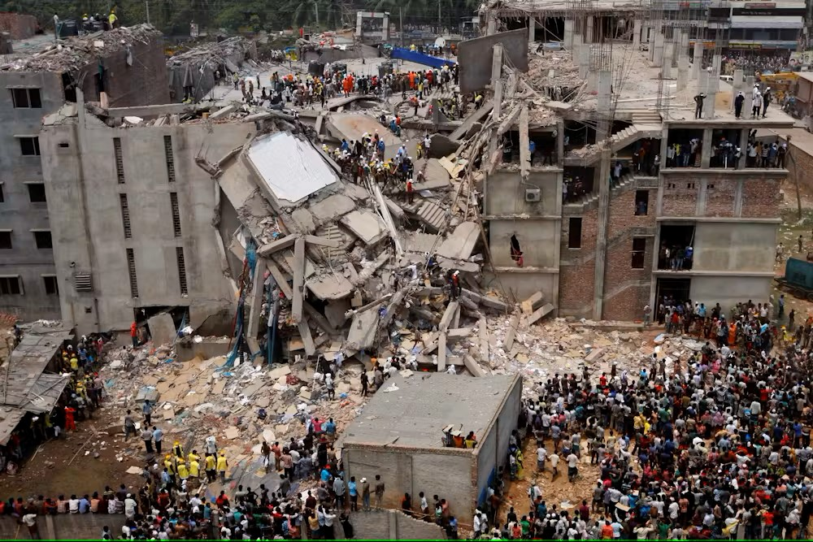
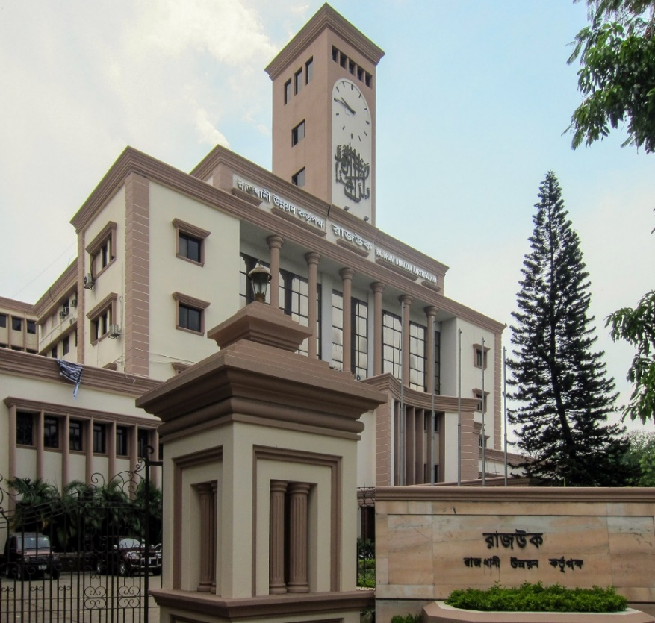
Illegal Construction
Not Approved
The dilemma is : whether the building owner should have spent more money to follow the law or saved money by ignoring safety rules.

Slide 11

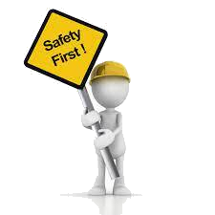

Worker Safety vs. Economic Pressure
Human lives
Force
Human lives
Threat
Deadline
Human lives
Losing wages
The question here is : Should financial deadlines have taken priority over ensuring human lives?"

Slide 12


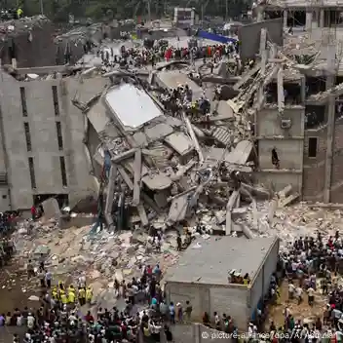
Global Supply Chain Responsibility
Maximum Production
Low production cost
Profit motives
Result
Lack of
employee safety
The dilemma is : whether the companies should have spent more money to ensure the worker’s safety and fairness."

Slide 13

Resolving The Ethical Dilemma
Four-Step Method
The structure had visible cracks and warnings the day before.
.
Building collapse killed 1,136 workers and injured 2,438.
Step 1
Identify The Facts
Factory owners forced workers to return despite evident risks.

Slide 14
Resolving The Ethical Dilemma
Four-Step Method
Main Ethical Dilemma
Profit vs Safety
Ethical Principles Violated
Causing harm to workers
Neglected by local authority
Step 2
Define the Ethical Issues
Stakeholders Involved
Factory Workers
Factory Owners
Local Authorities:

Slide 15
Resolving The Ethical Dilemma
Four-Step Method
Continue operations (what actually happened).
Stop production and evacuate workers.
Step 3
Evaluate Alternative Action
Strengthen international oversight.
Enforce stricter local governance.

Slide 16
Resolving The Ethical Dilemma
Four-Step Method
Prioritizes worker safety and aligns with ethical principles.
Factory owners must ensure compliance with safety standards.
Step 4
Best Course of Action
Governments must enforce regulations and provide safety nets for workers.

Slide 17

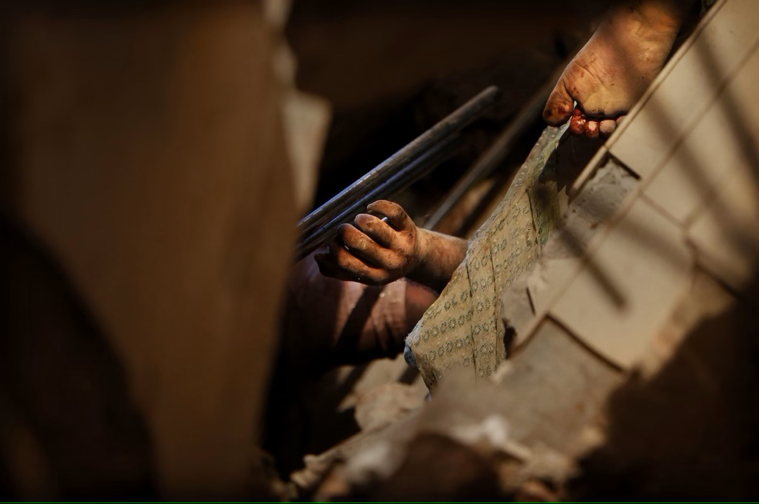
Conclusion
Lessons Learned:
Ethical decision-making must prioritize human
lives and safety above profits.
Strengthened governance and global
accountability is critical to preventing such
disasters.

Slide 18
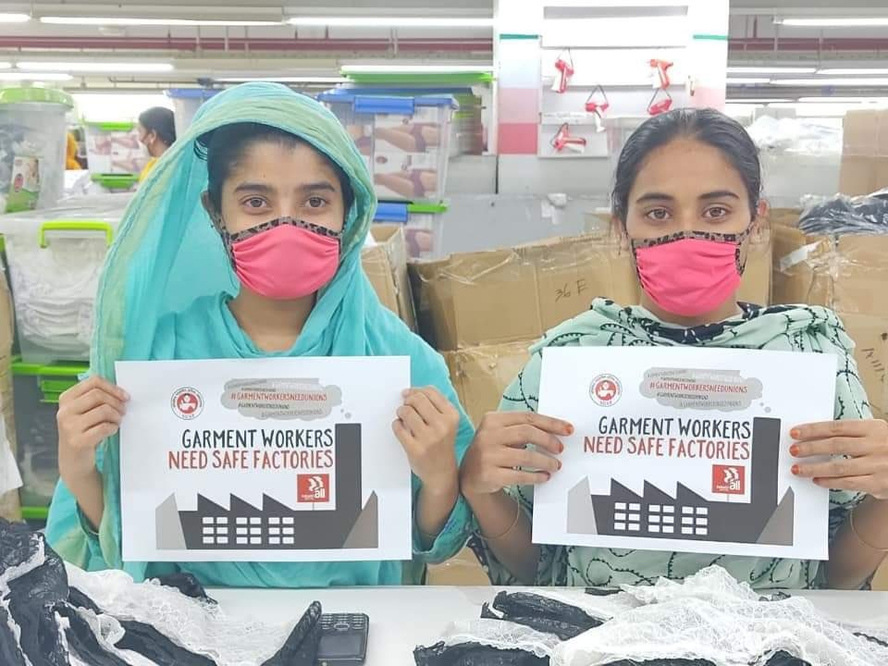
Conclusion
Call to Action:
Advocate for national and global reforms to
enforce ethical labor practices in the fashion
industry.
Ensure ongoing support for victims and
implement preventive measures to secure safer
working Environments.
.

Slide 19

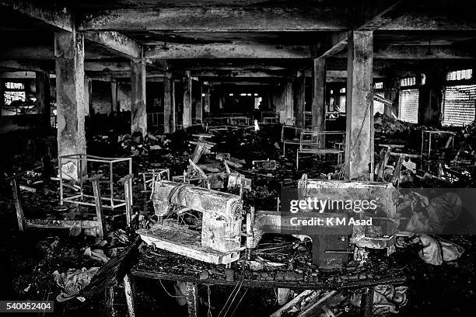
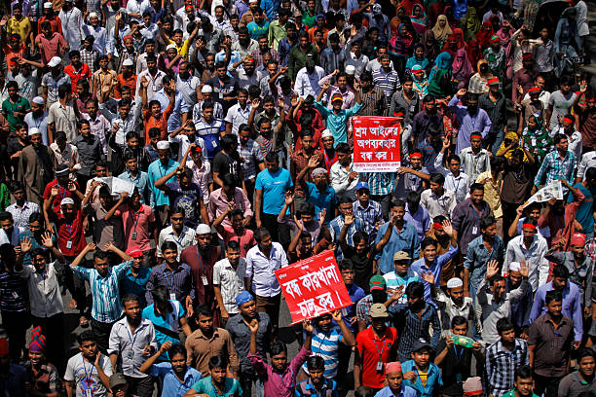
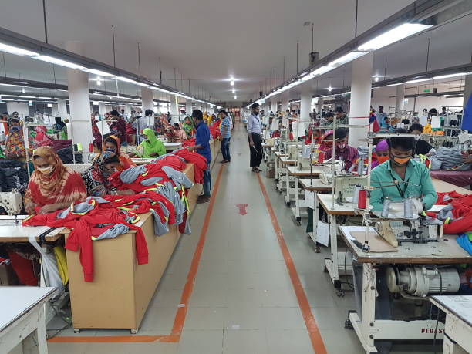
.

Slide 20
Thank you

